Slide 1
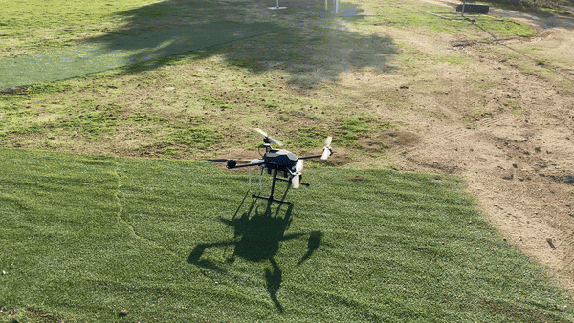
Applications of Autonomous Drones for Non-Terrestrial Networks in Remote Areas
By: Andrés Navarro Pedregal
Tutor: José Alberto Hernandez Gutiérrez

Slide 2
Table of contents
01
02
03
04
05
06
Introduction & Objectives
Technical Details
Building the Drone
Building the System
Flight Tests
Conclusions

Slide 3
01
Introduction & Objectives

Slide 4
Project & Objectives
Study of UAVs for NTNs applications
Viability of UAVs for NTNs
Develop BOM, manual of design, etc
Create a budget UAV for research
Human rescue tasks with ML and VR goggles
Application of UAVs for remote areas

Slide 5
02
Technical Details

Slide 6
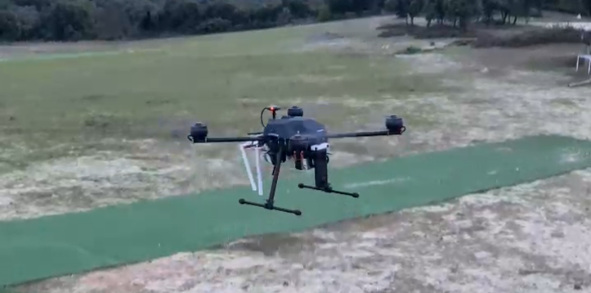
Flight performance
Weight: 6.5KG
Range: Up to 40Km
Flight time: 25-35 minutes
Autopilot capabilities
Retractable landing gear

Slide 7
Main components
Price: 2600€
Frame | Tarot X690 | 17 inch propellers
Motors | T Motor U7 490kv | Up to 3kg per motor
Esc | TMotor Flame 70A LV
Flight controller | Pixhawk 6c | Using Ardupilot
GPS | Holybro M9N | 1.5m CEP precision
Battery | Tattu 4s 22Ah
Radio link | RFD868x | With mavlink telemetry
Controller | Radiomaster TX16S MAX

Slide 8
5G NTN Components
Price: 1800€
Onboard Computer | Jetson Orin Nano | 8GB RAM 5.3 FP32 TFLOPs
360 camera | Ricoh Theta X | 4K 30fps usb stream
4G/5G router | (GL-X750V2) Smart WiFi | Dual band, OpenWrt

Slide 9
03
Building the Drone
Detail of the drone built: arXiv:2409.19337

Slide 10
Drone Architecture
360 Camera
Onboard
computer
5G Router
PDB
Battery
Telemetry Control
Motors
ESC
Flight Controller
GPS

Slide 11
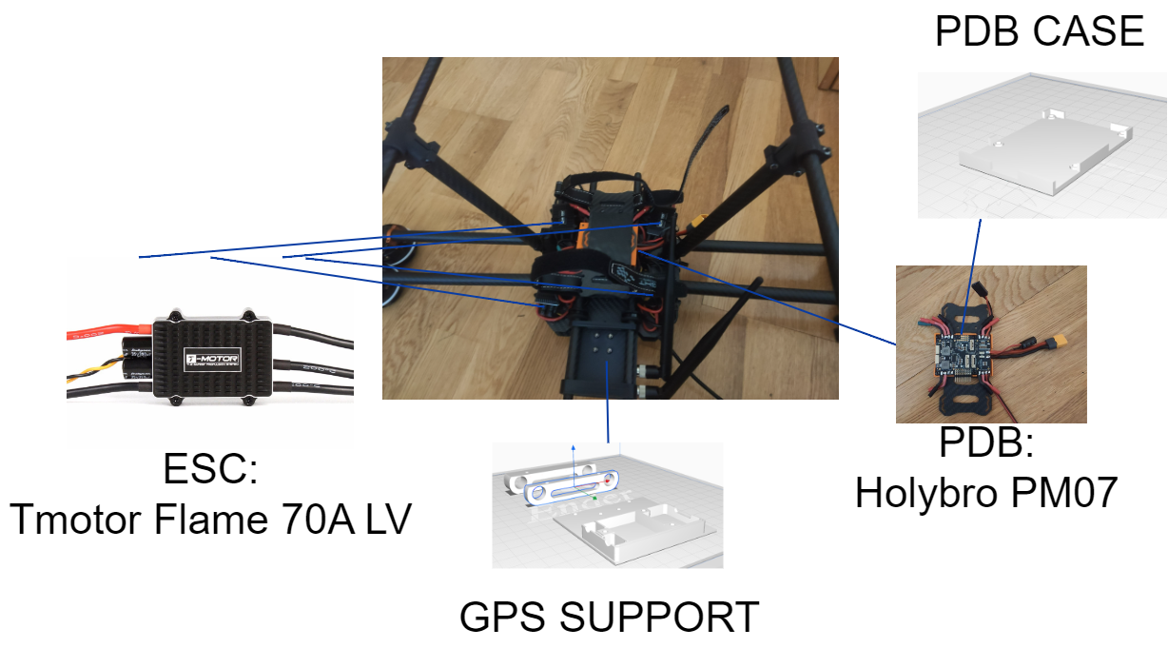
Component placement

Slide 12
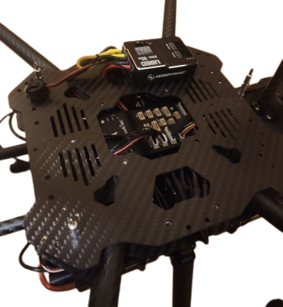
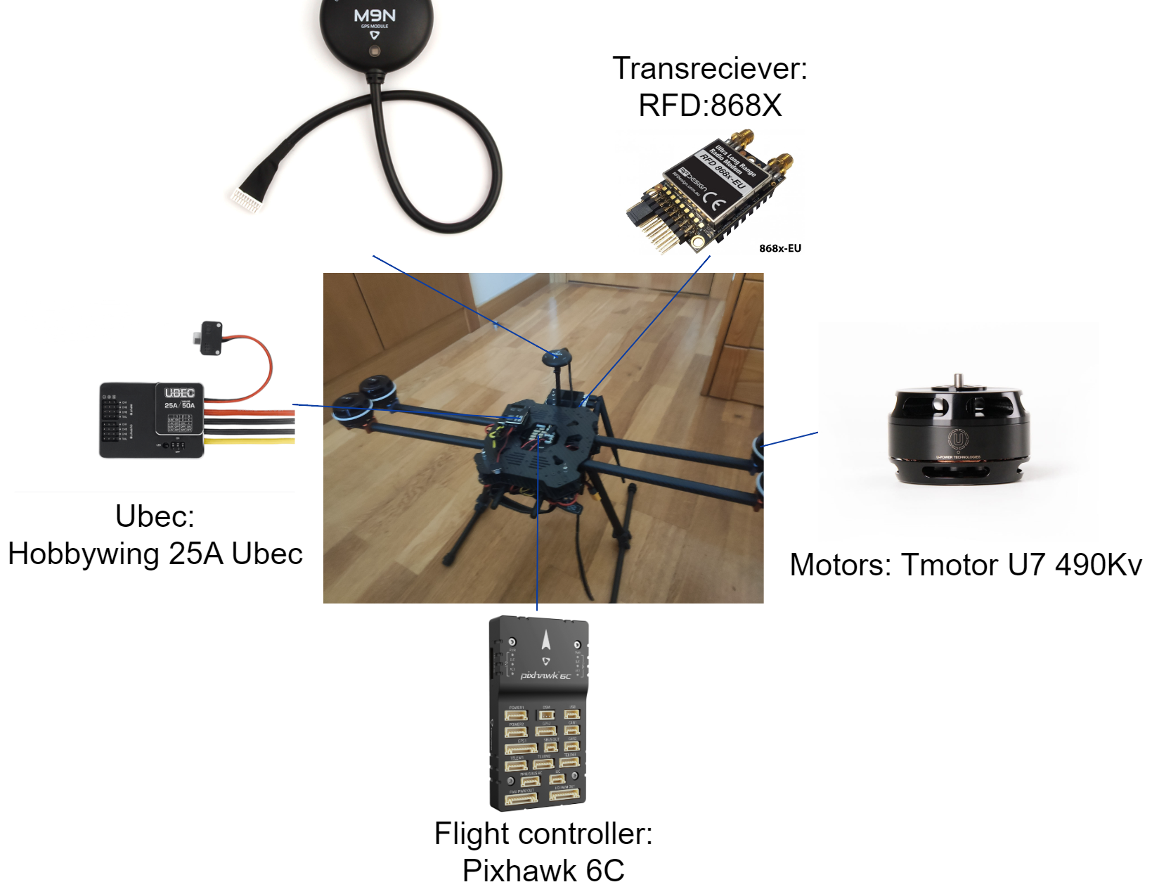
Component placement

Slide 13
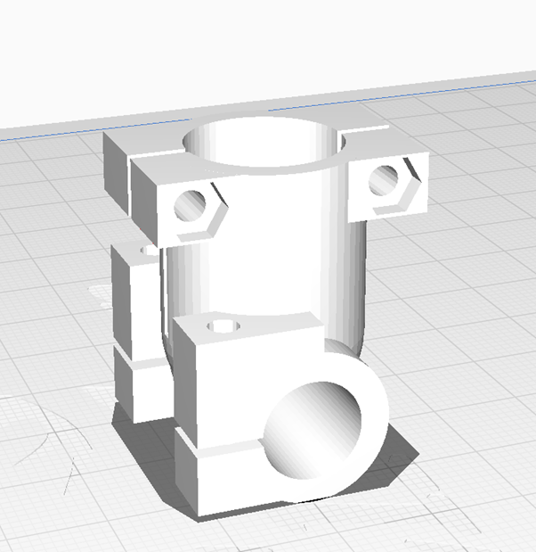
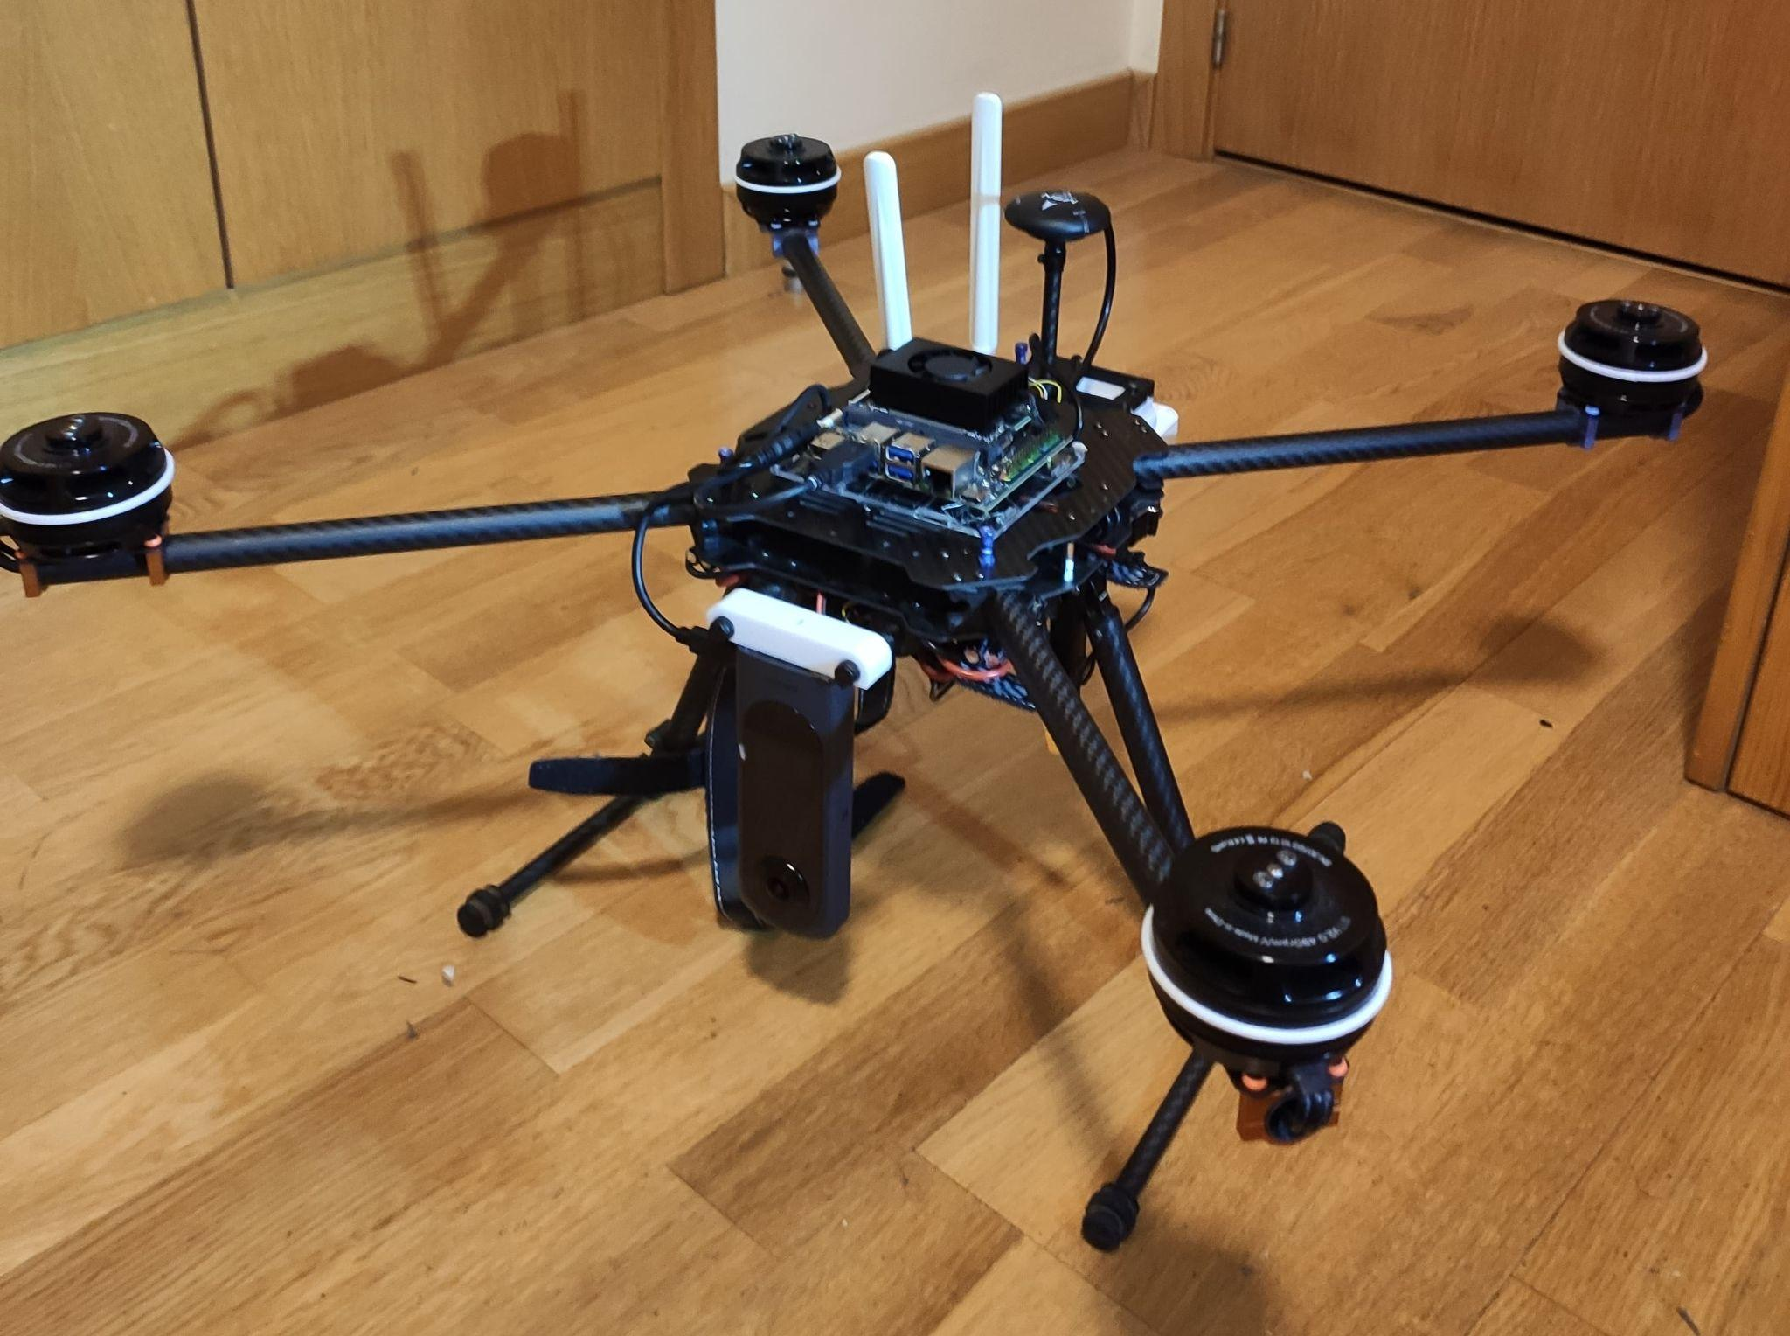
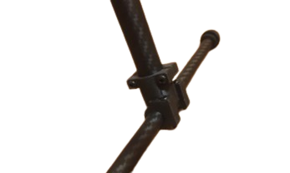
3D printed parts

Slide 14
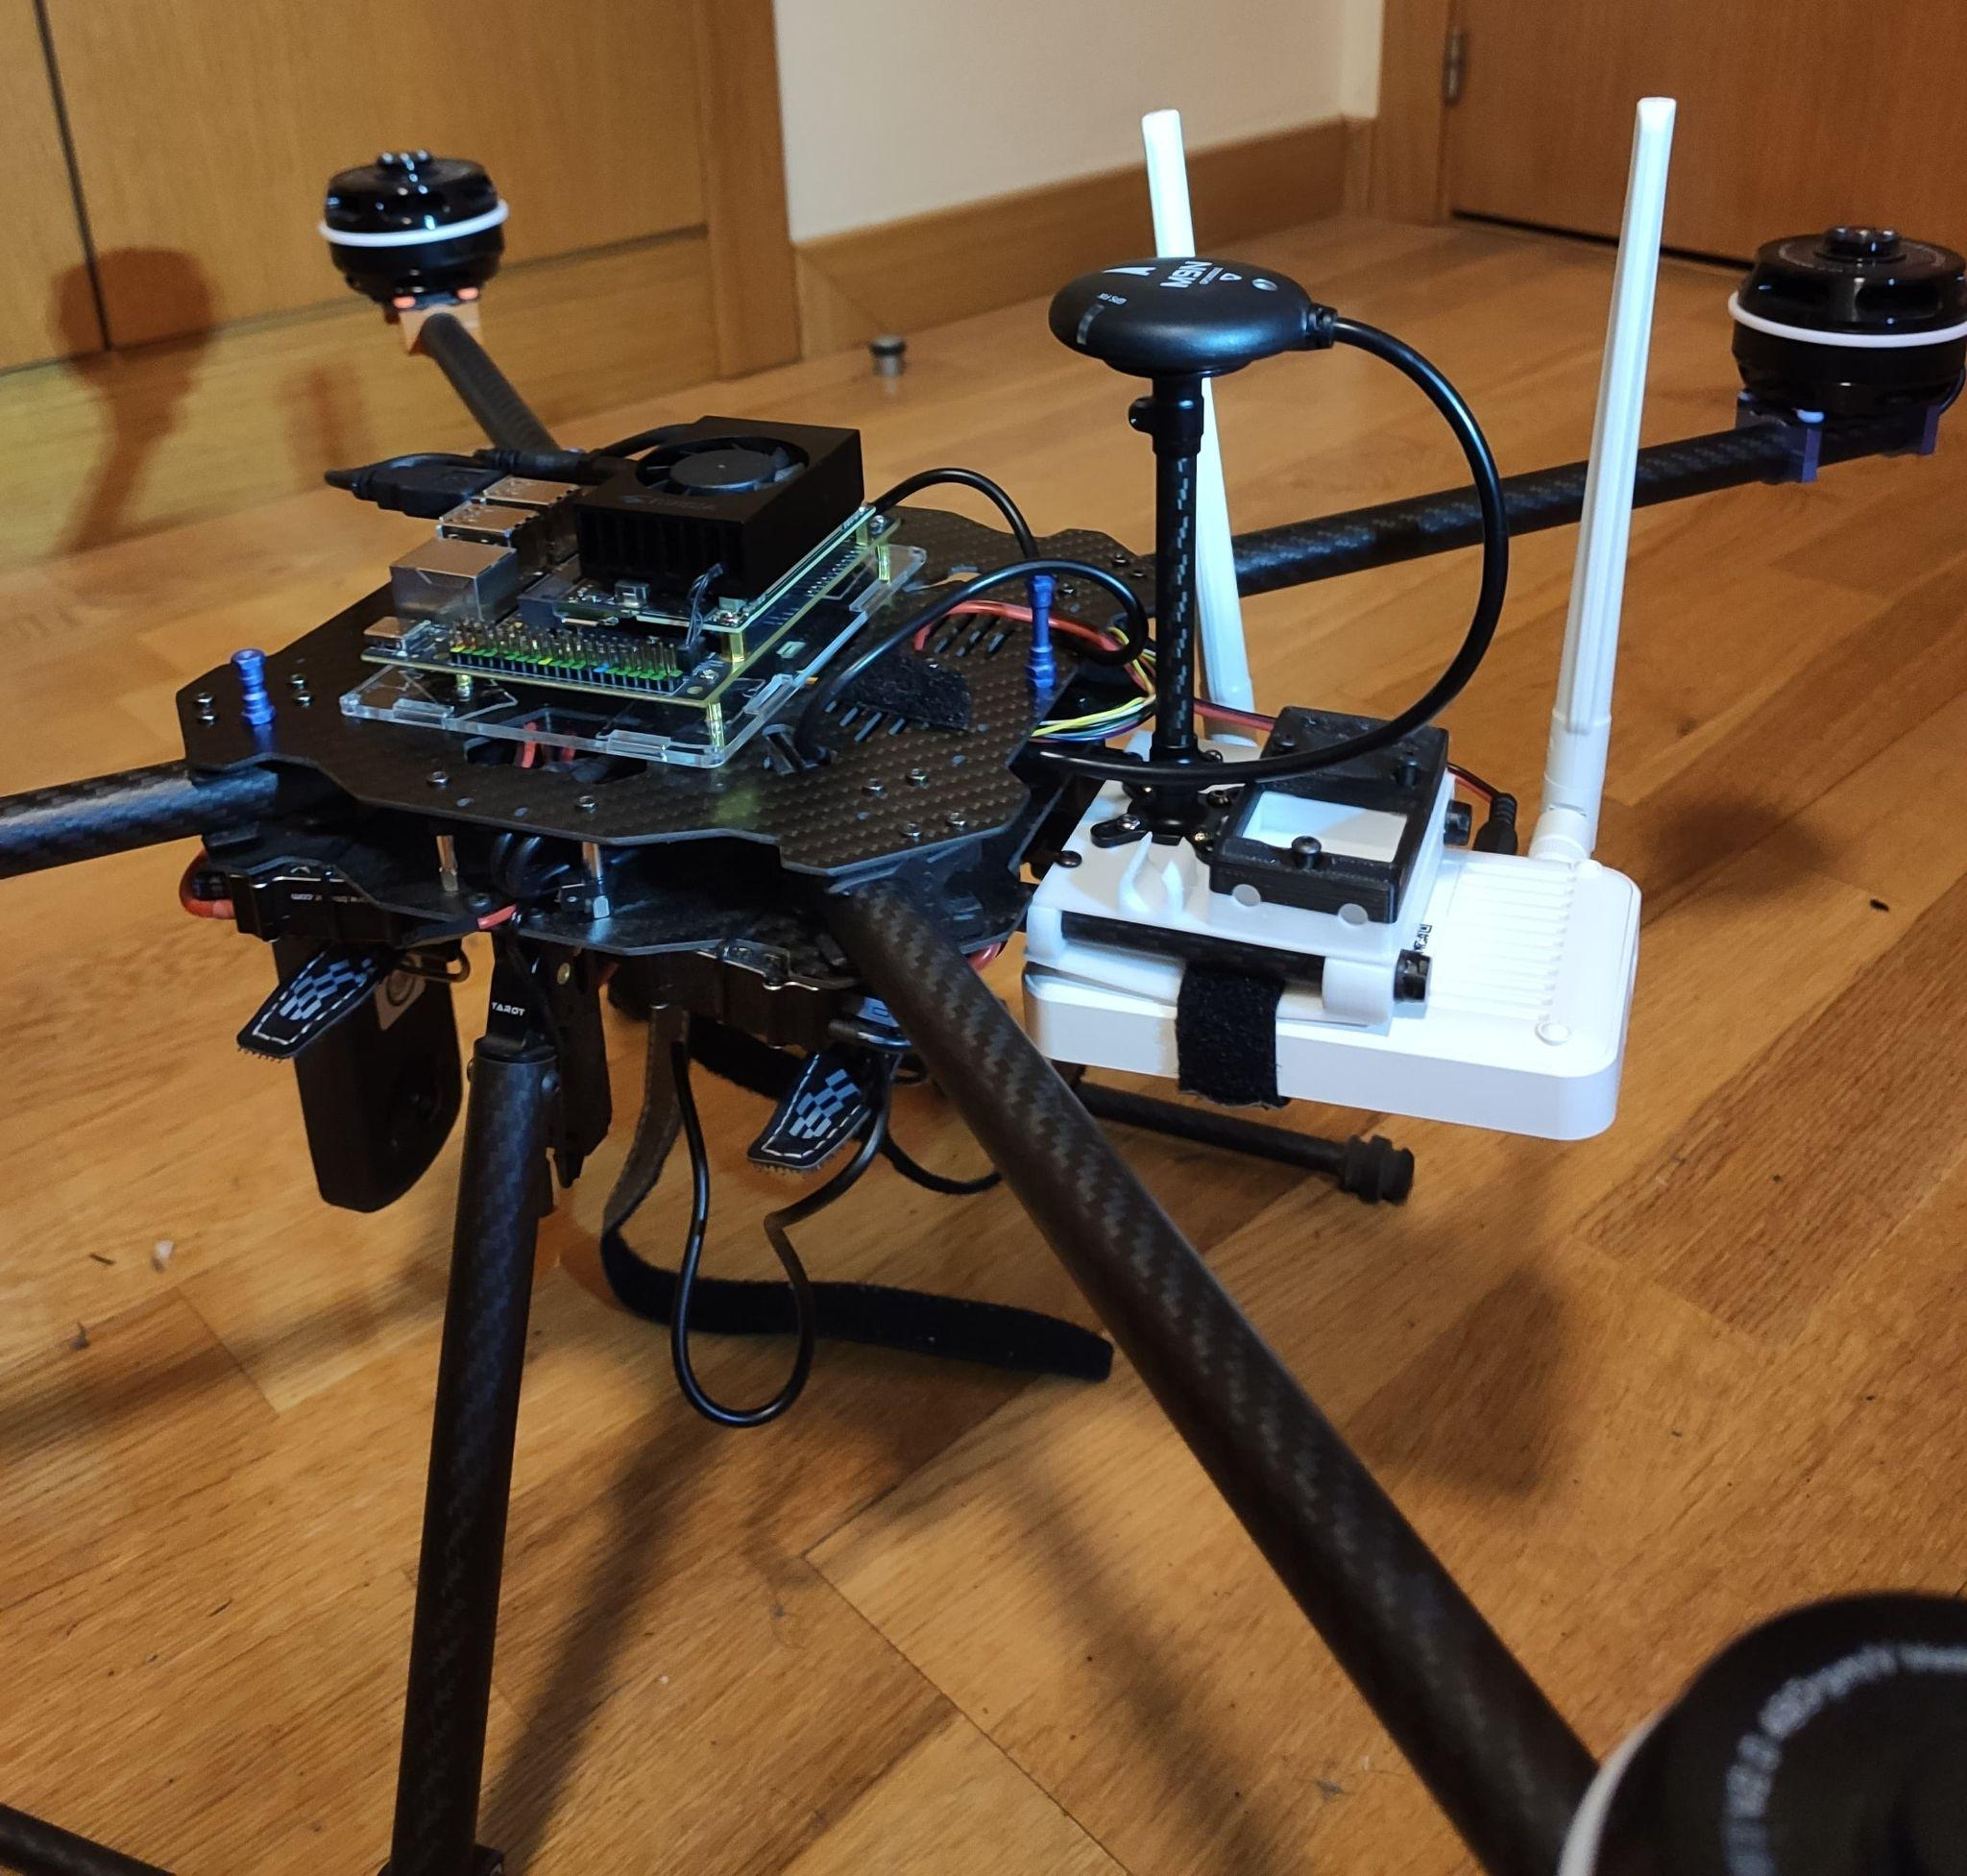
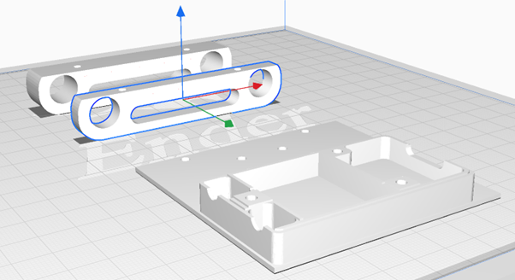
3D printed parts

Slide 15
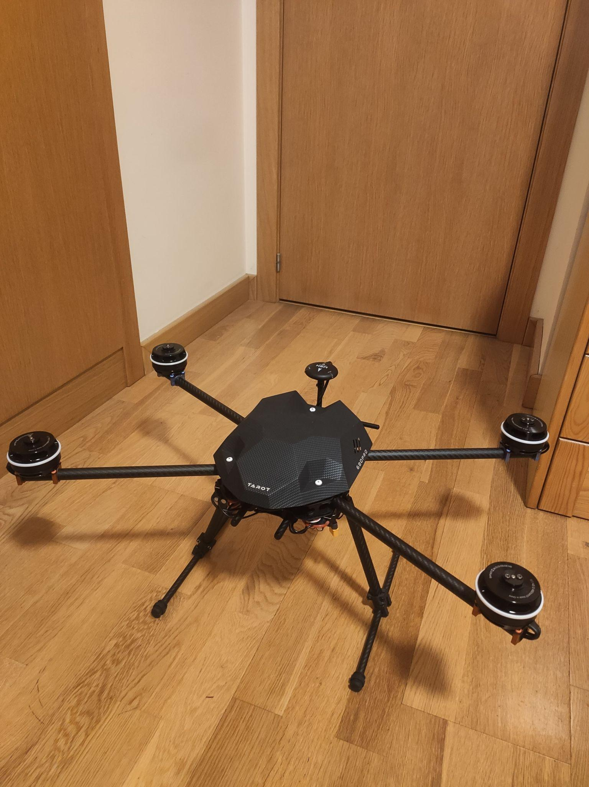
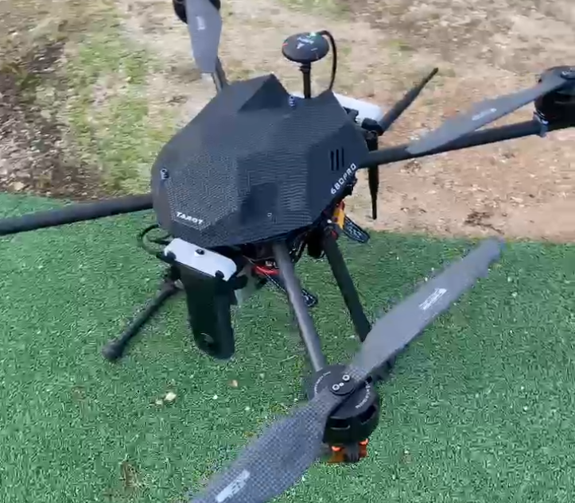
Build Complete!

Slide 16
04
Building the System

Slide 17
Steps
💻 Edge Computing
🧍 Detect People
🚨 Monitor Alerts
🥽 VR Integration

Slide 18
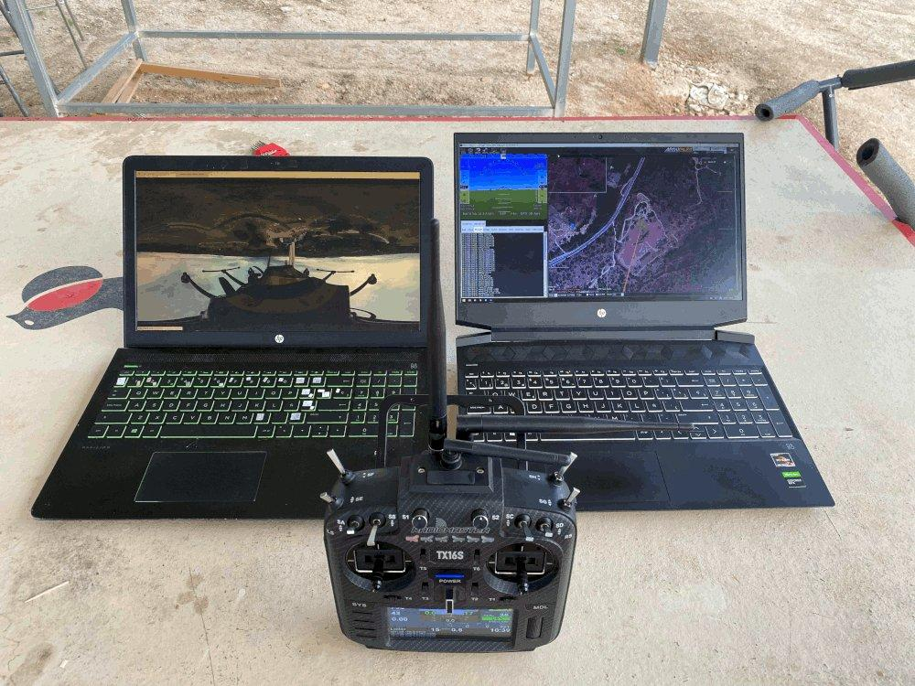
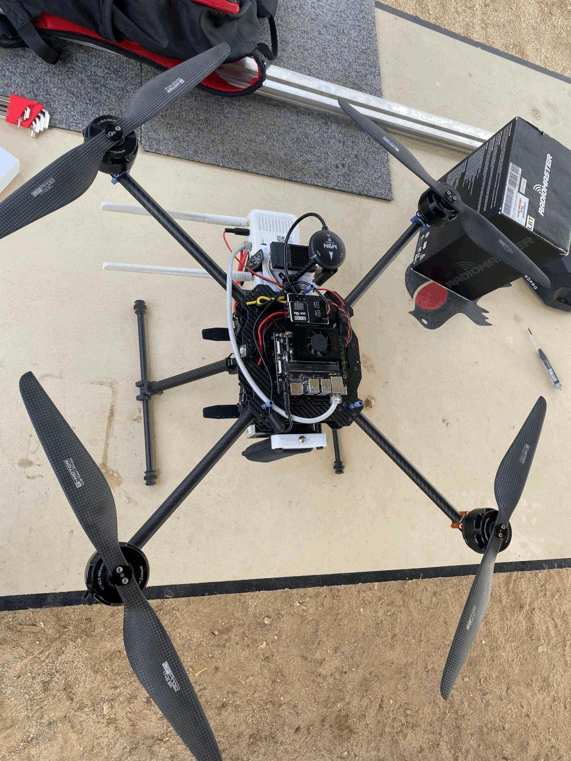
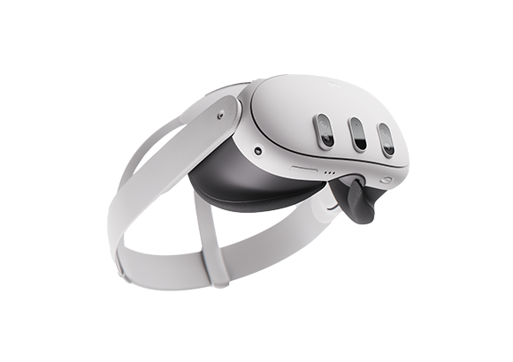
High Level Overview
☁️
Server
VR Goggles
Drone
Experiments with Meta Quest 3: 10.1109/ICTON62926.2024.10647326

Slide 19
Architecture
🔍
🚨
Object Detection
Alert
📷
💻
Server
360 camera
Object Detection
🧠
🌐
LLM Integration
Drone
VPN Tunnel

Slide 20
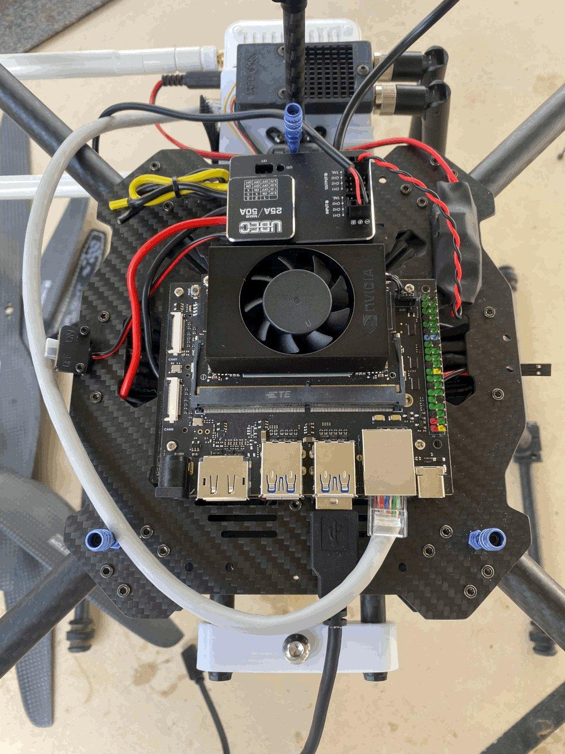
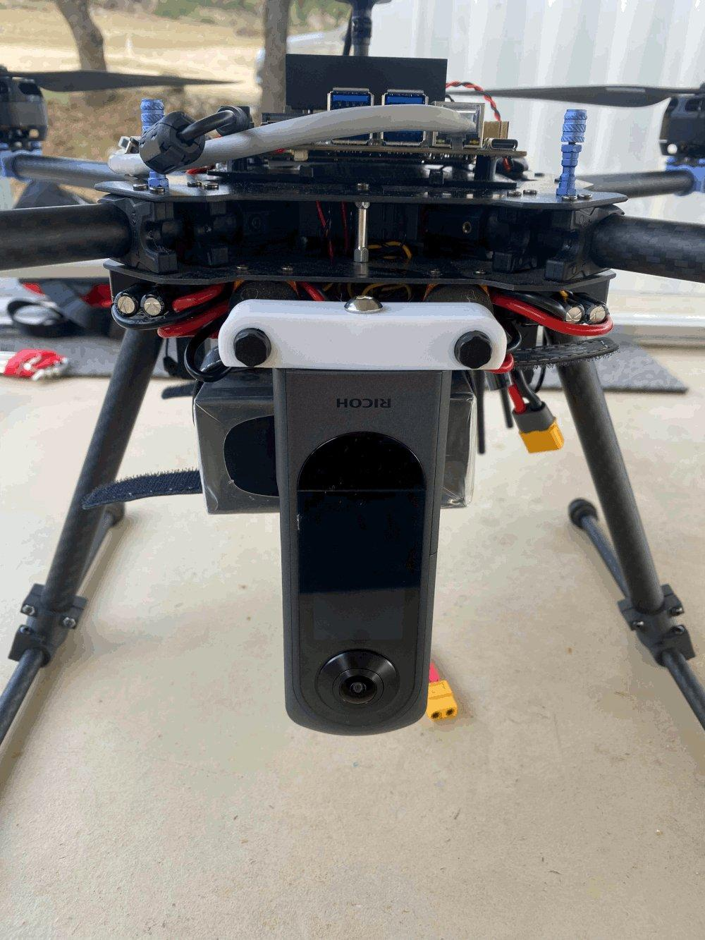
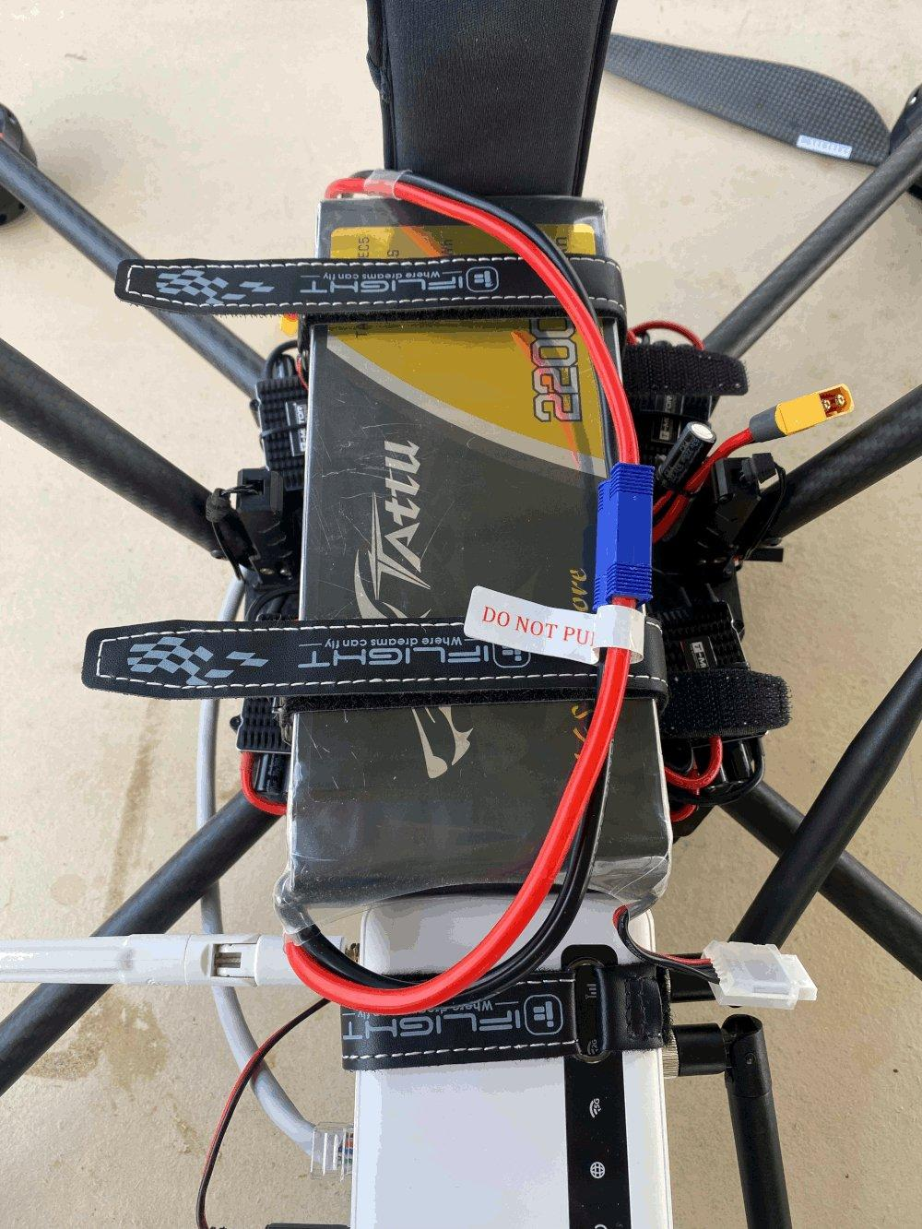
Drone
Edge Computer with GPU
360 Camera
Router

Slide 21
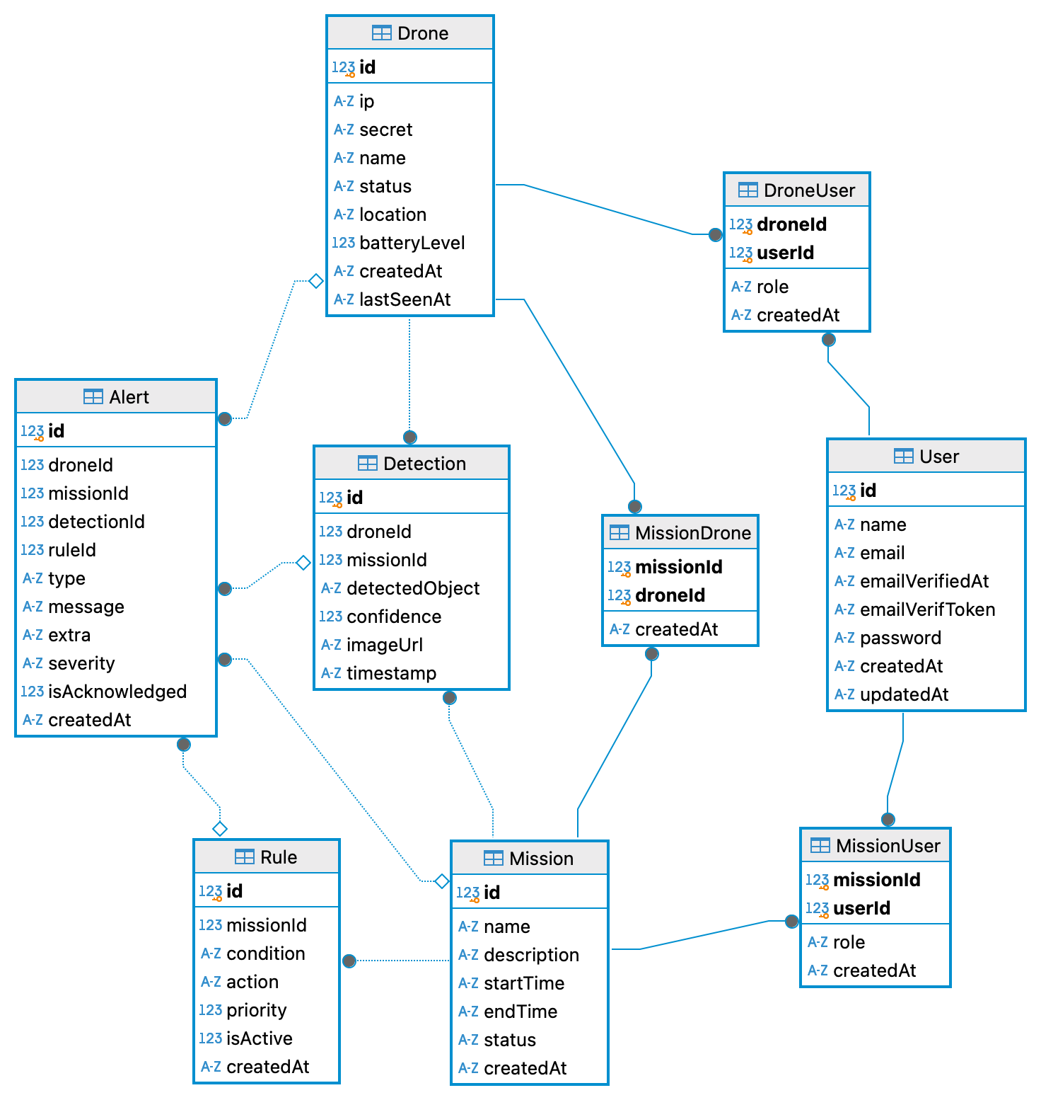
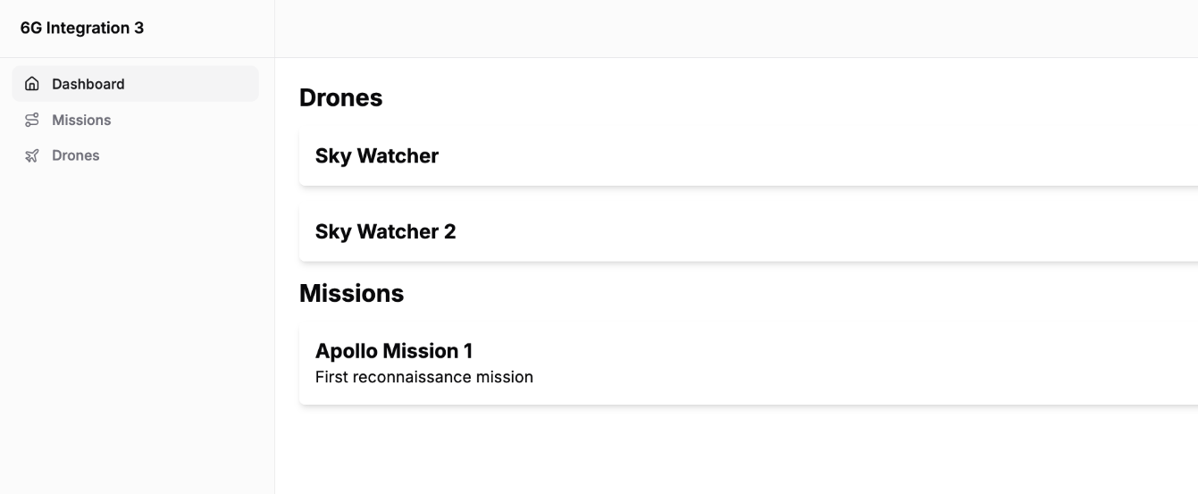
Server

Slide 22
DB Schema
📸
🚁
🚁
🚁
Detection
🚨
Drone
Alert
🟰
🗺️
🧍
🗺️
Rules
User
Mission

Slide 23
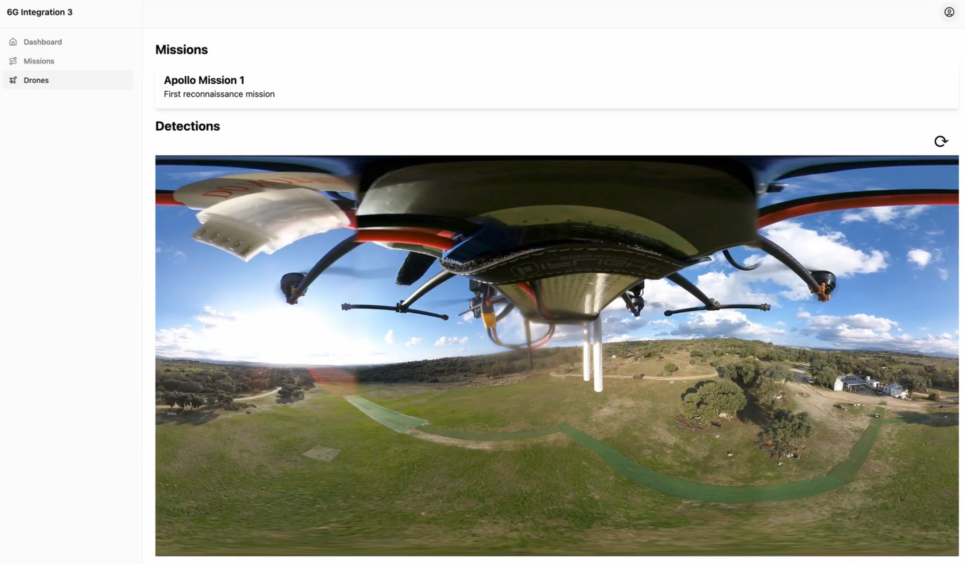
Live Connection of the Camera

Slide 24
05
Flight Tests

Slide 25
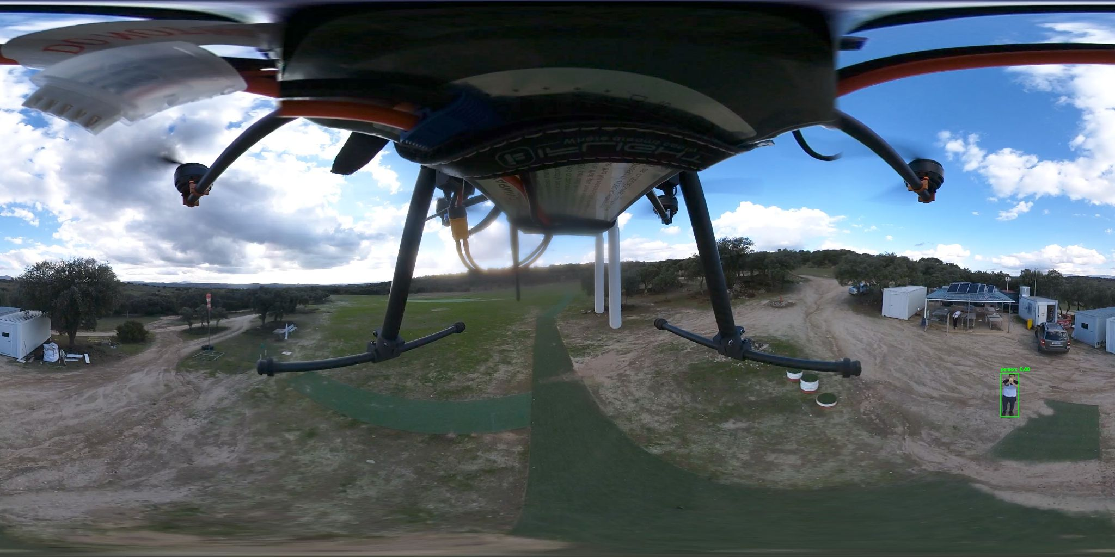
Detection Tests

Slide 26
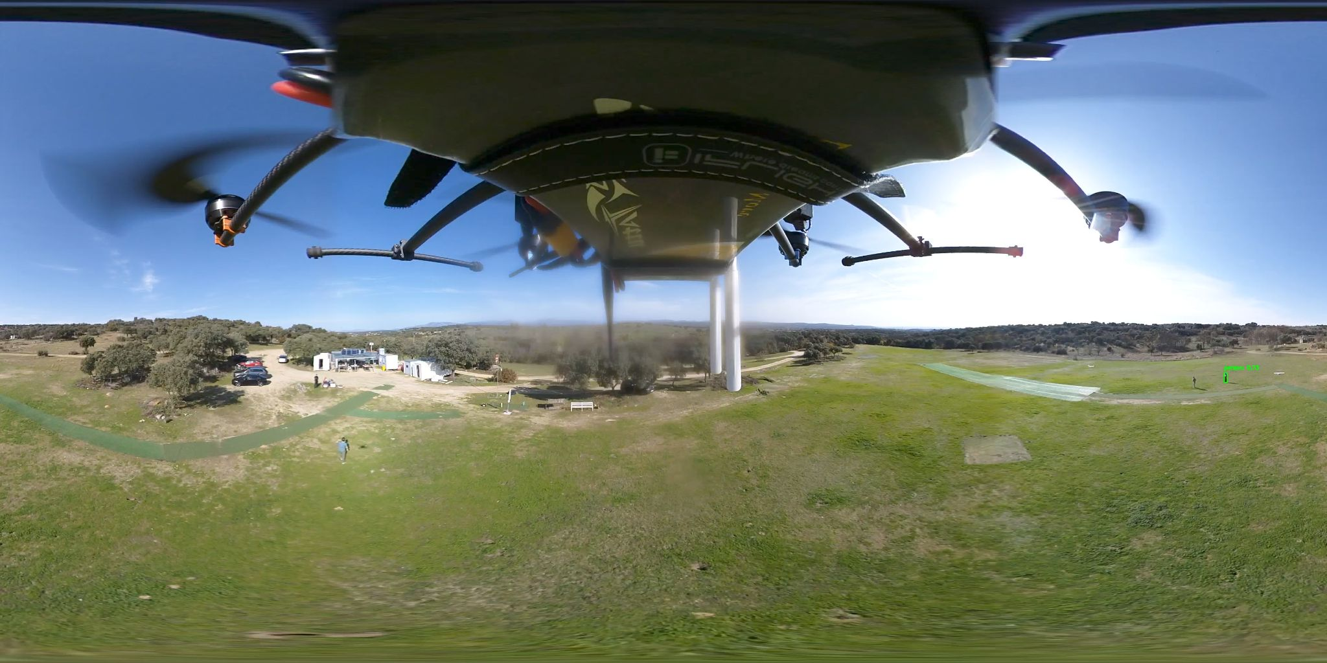
Detection Tests

Slide 27
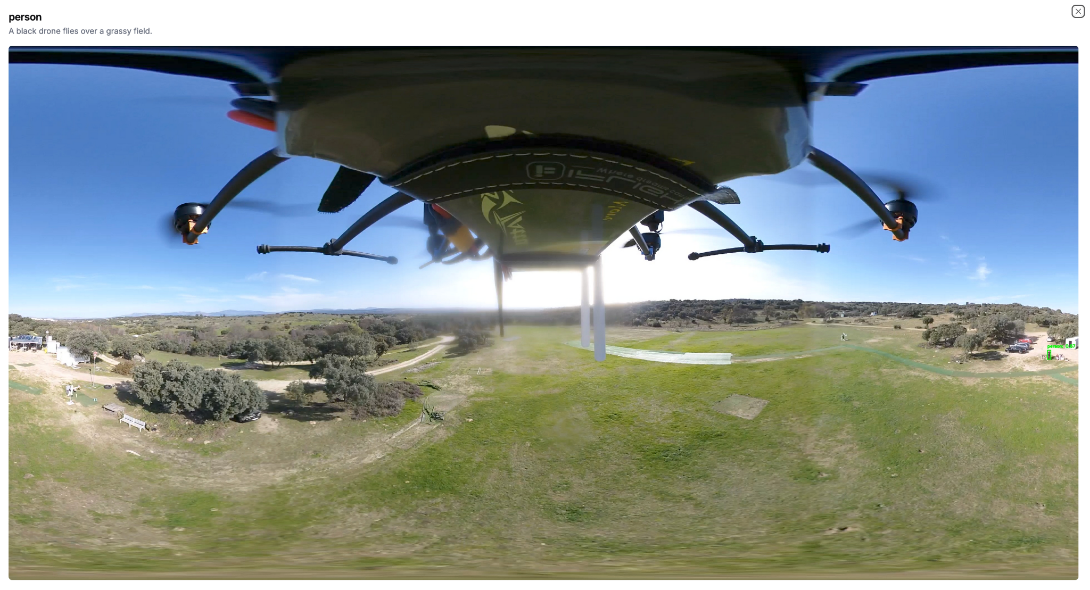
LLM functionality

Slide 28
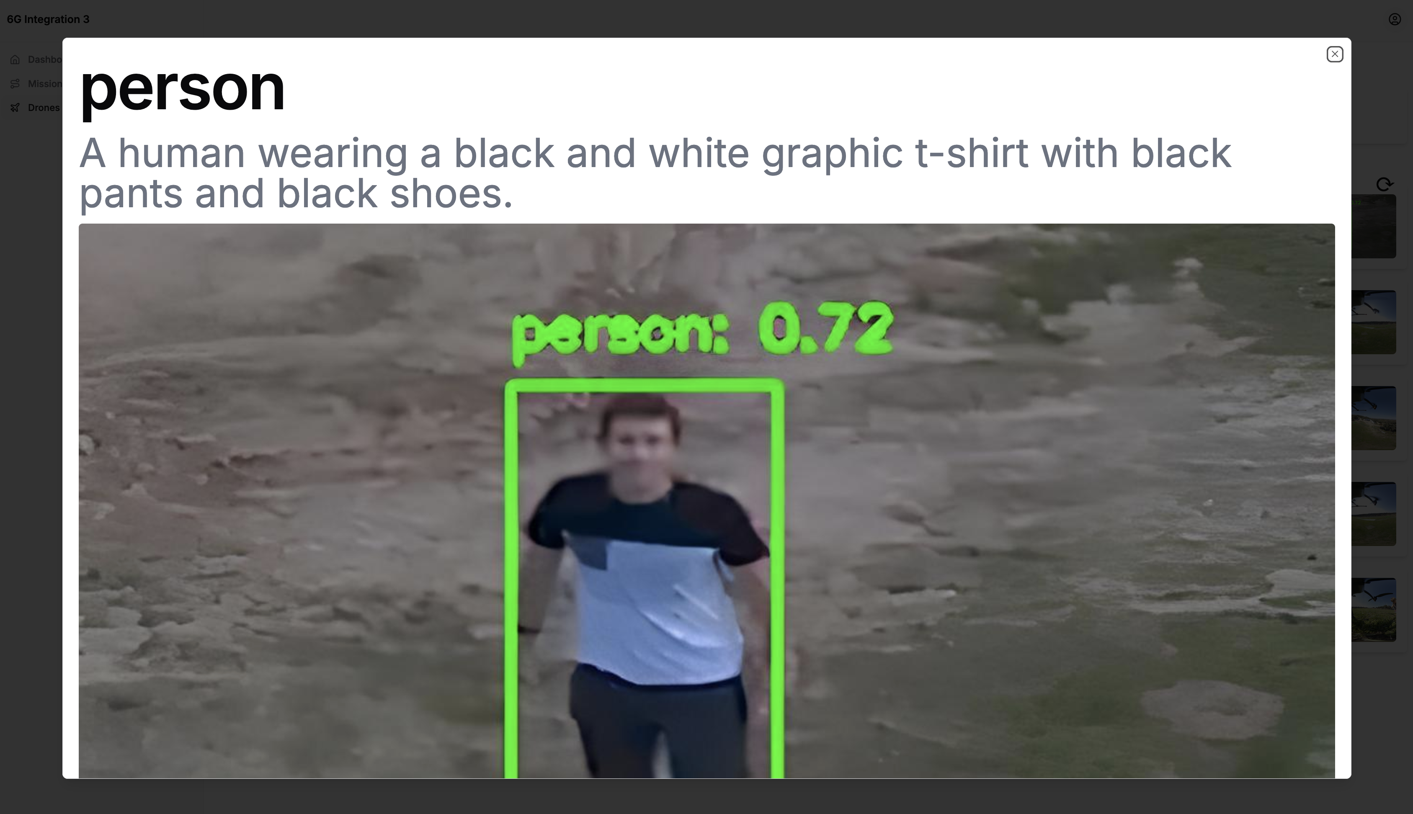

Slide 29
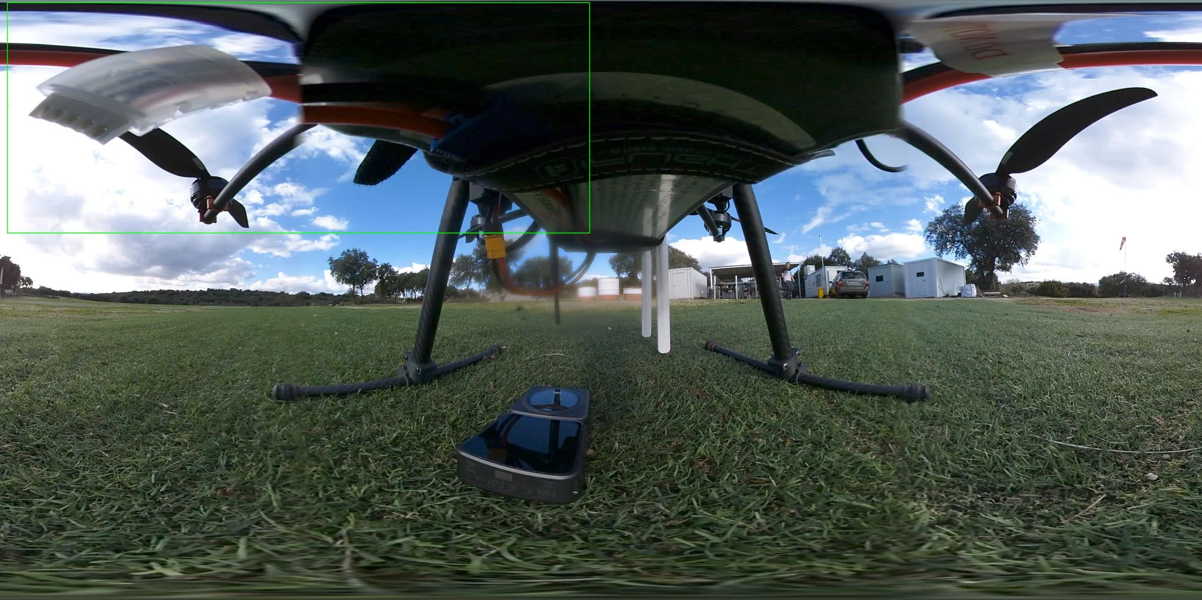
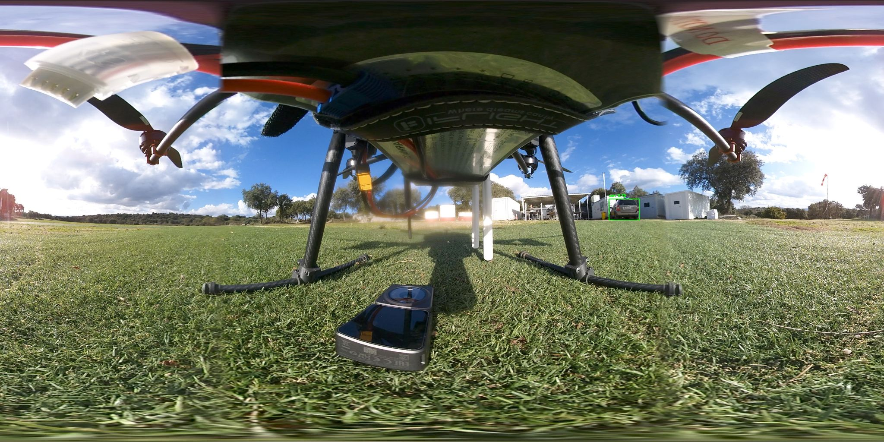
Random Detections

Slide 30
Flight Time: 30min
Detect Anything
Real Time Video Tx
Even the drone itself!

Slide 31
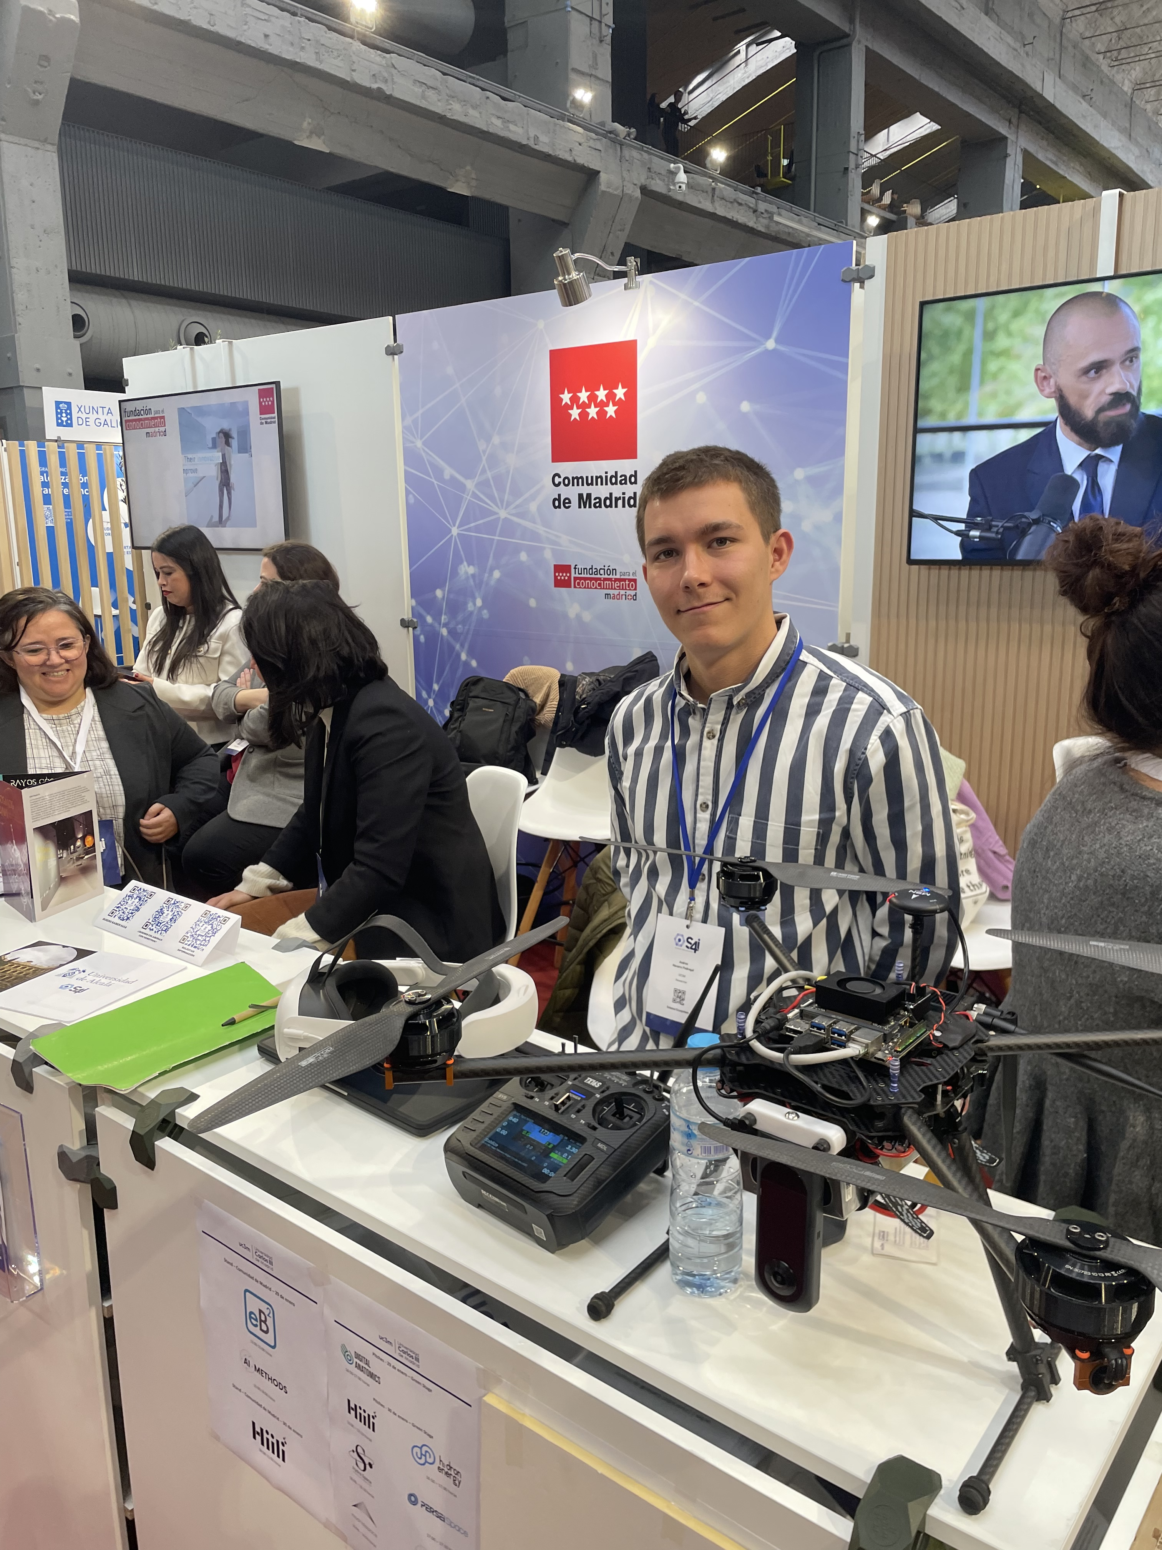
Presented in the Science for Industry (S4I) Conference

Slide 32
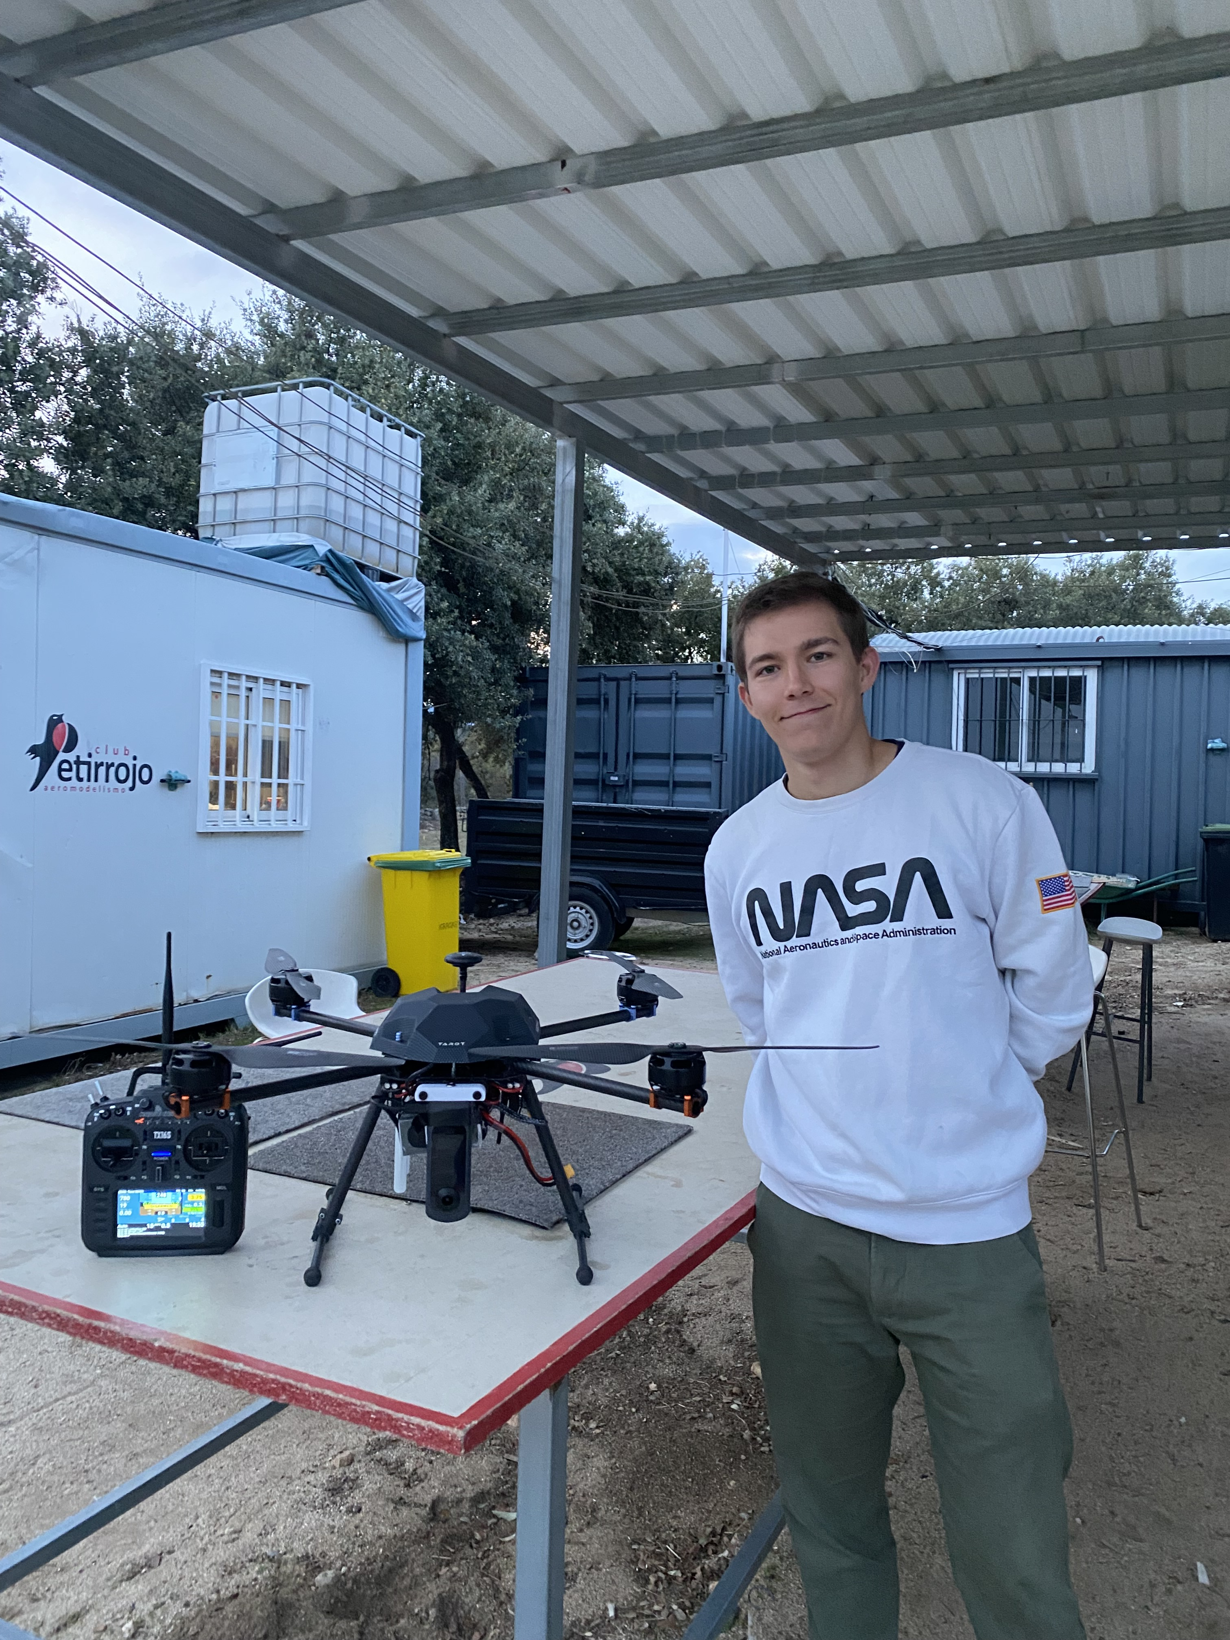
Thank you!
Any questions?

